Slide 1
Module 3
Context based and Interaction Based Prompts: Context Based – Contextual Based and Delimiter Based, Structured Prompt, Interaction Based – Multi-Prompt, reflection-based Prompts.

Slide 2
Context Based Prompt Engineering
Context-based prompts involve providing an AI with background information, situational details, and specific parameters to ensure its response is relevant and accurate. This technique, often called In-Context Learning (ICL), allows models to adapt without additional training.
Core Components of a Contextual Prompt
Situational Context: The specific scenario or environment (e.g., "This is for an internal executive review").
Audience Context: Defining the end-user (e.g., "Explain this to a 5th grader").
Goal Context: Clearly stating why you need the output and what success looks like.
Constraint Context: Setting boundaries like word count, tone, or specific formatting.
Domain Context: Providing industry-specific background or assuming a persona (e.g., "You are a senior copywriter").

Slide 3
General Structure of a Context-Based Prompt
Context: <background information>
Task: <what the model should do>
Constraints (optional): <format, style, length>

Slide 4
Types of Context-Based Prompts
User Context: Provides information about who the user is (age, role, skill level).
Context: The learner is a beginner in Python.
Task: Explain variables.
Constraints: Simple language.

Slide 5
Domain / Subject Context
Specifies the field or domain to which the task belongs.
Context: This question is related to Python OOP.
Task: Explain inheritance.
Constraints: Use code example.

Slide 6
Educational / Level Context
Defines the academic level of the audience.
Context: First-year engineering students.
Task: Explain polymorphism.
Constraints: Short explanation.

Slide 7
Situational Context
Describes the scenario or use case in which the response will be used.
Context: You are preparing content for a 3-hour lecture.
Task: Divide the syllabus into modules.

Slide 8
Data Context
Supplies specific input data that the model must use.
Context: Student marks = [78, 85, 92, 66].
Task: Calculate average and grade.
Conversational Context
Uses previous discussion or interaction history as context.
Context: In previous messages, inheritance was explained.
Task: Now compare inheritance and composition.

Slide 9
Output / Formatting Context
Defines how the output should be structured.
Context: Output will be used in an exam answer.
Task: Explain encapsulation.
Constraints: 5–6 lines, no bullet points.

Slide 10
Compliance / Safety Context
Adds rules, policies, or ethical boundaries.
Context: Follow healthcare safety guidelines.
Task: Explain diabetes.
Constraints: Educational only, no medical advice.

Slide 11
Industry Requires Context-Based Prompts
Generic prompts lead to:
Incorrect outputs
Hallucinations
Compliance risks
Inconsistent results

Slide 12
Domain-Specific Accuracy : The model must operate within the correct industry domain.
User & Role Awareness : Responses must adapt to the user’s role and expertise.
Task & Goal Clarity: Industry prompts are goal-oriented, not open-ended.
Controlled & Structured Output : Outputs must be consistent and reusable.
Data Grounding & Accuracy : The model must use only provided data and avoid assumptions.
Compliance, Ethics & Safety : Mandatory in regulated industries.
Consistency Across Multiple Queries: AI responses must remain consistent across sessions and users.
Scalability & Reusability: Prompts should be reusable across teams and applications.

Slide 13
Delimiter Based Prompt
Delimiter-Based Prompting is a prompt engineering technique where special symbols or markers (delimiters) are used to clearly separate instructions, context, and input data so the model understands exactly which text to act on.
Without delimiters:
Instructions and data get mixed
Model may hallucinate
Higher risk of prompt injection
Unclear boundaries

Slide 14
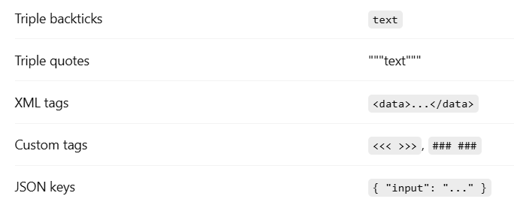
Common Delimiters Used

Slide 15
General Structure of a Delimiter-Based Prompt
Instruction:
<what to do>
Input Data:
<<<
<text or data>
>>>
Output:
<expected format>

Slide 16
Types of Delimiter-Based Prompts
Code Block Delimiters : Code, text analysis, summarization
Summarize the following text:
Artificial Intelligence is transforming industries...
Custom Symbol Delimiters : Extract keywords from the text below:
<<<
Machine learning improves automation and analytics.
>>>

Slide 17
XML / Tag-Based Delimiters
Used in: Enterprise & structured prompts
Analyze the content inside <article> tags only.
<article>
AI adoption is increasing in healthcare.
</article>

Slide 18
JSON-Based Delimiters
Used for: APIs, automation pipelines
Read the following JSON and extract customer_name.
{
"customer_name": "Ravi",
"account_type": "Savings"
}

Slide 19
Multi-Section Delimiter Prompts
### Context ###
You are an AI tutor.
### Input ###
Explain inheritance in Python.
### Output ###
Simple explanation with example.

Slide 20
Industry Uses Delimiter-Based Prompts
In real-world AI systems, models handle:
Large documents
User-generated content
Code and logs
Sensitive or regulated data
Without delimiters, instructions and data can mix, causing:
Wrong outputs
Prompt injection risks
Compliance issues

Slide 21
Structured Prompt
Structured Prompting is a prompt engineering technique where the prompt is organized in a clear, predefined structure with separate sections for context, instructions, input, constraints, and output.
Structured Prompts Are Used
Reduces ambiguity
Ensures model outputs follow a consistent format
Makes prompts scalable and reusable
Essential for industry applications like reporting, code generation, and data extraction
Reduces hallucinations and improves alignment with business requirements

Slide 22
General Structure of a Structured Prompt
### Context ###
<Background or scenario information>
### Task ###
<What the AI needs to do>
### Input ###
<Data or text to process>
### Constraints ###
<Rules: style, format, length, tone>
### Output ###
<Expected format or example>

Slide 23
Types of Structured Prompts
Instruction + Input Structure
Separates task instruction from input data
Instruction: Summarize the following text in 3 bullet points.
Input:
<<<
Artificial Intelligence is revolutionizing industries by improving automation, data analytics, and decision-making processes.
>>>

Slide 24
Contextual Structured Prompts
Adds scenario or user-specific context for better relevance.
Context: The audience is first-year engineering students.
Task: Explain inheritance in Python.
Input:
<<<
Python code: class Animal: ...
>>>
Constraints: Use simple language, real-world example
Output: Explanation + short code example

Slide 25
Multi-Section Structured Prompts
Organizes prompts into multiple labeled sections for complex tasks
### Context ###
You are an AI assistant for business analytics.
### Input ###
Sales data for Q3: [100, 150, 200, 250]
### Task ###
Identify key trends
### Constraints ###
Provide in bullet points, maximum 50 words
### Output ###
- Bullet-pointed summary

Slide 26
Template-Based Structured Prompts
Uses a predefined template for repeated tasks.
Template:
Context: {user_context}
Task: {task_description}
Input: {input_data}
Constraints: {constraints}
Output: {expected_format}

Slide 27
Interaction Based Prompt
Interaction-Based Prompting is a technique where the prompt is designed to simulate a conversation or interactive scenario, guiding the AI model to respond in a stepwise, iterative, or dialog-like manner.

Slide 28
Structure of Interaction-Based Prompt
[Goal]
↓
[Context]
↓
[Role]
↓
[Instruction Style]
↓
[AI Response]
↓
[User Feedback]
↓
[Refinement]
↓
[Improved Response]
↓
(Repeat Cycle)
Act as a Python trainer. I am a beginner. Teach me abstraction step-by-step. Use simple language. Ask me a question after each step. Wait for my reply before continuing.

Slide 29
Types of Interaction-Based Prompts
Follow-Up Prompt
Clarification Prompt
Refinement / Improvement Prompt
Correction Prompt
Step-by-Step Interaction Prompt
Role-Switching Interaction Prompt
Feedback-Driven Prompt
Exploratory / Conversational Prompt

Slide 30
Follow-Up Prompt
A Follow-Up Prompt is an interaction-based prompt where the user asks additional questions or instructions based on the AI’s previous response to gain deeper, clearer, or more specific information.
Structure of a Follow-Up Prompt :
Initial Prompt – User asks the main question
AI Response – AI provides the first answer
Follow-Up Prompt – User asks for more details, clarification, or expansion
Refined Response – AI improves or extends the answer

Slide 31
Simple Example – Follow-Up Prompt
User:
What is a list in Python?
AI:
A list is a collection of items stored in a single variable.
User (Follow-Up Prompt):
Give a simple example.
AI:
numbers = [1, 2, 3, 4]

Slide 32
Clarification Prompt
A Clarification Prompt is an interaction-based prompt used when the user asks the AI to explain the same response more clearly, simply, or in a different way without changing the topic.
Structure of a Clarification Prompt
Initial Prompt – User asks a question
AI Response – AI gives an explanation
Clarification Prompt – User requests simpler or clearer explanation
Clarified Response – AI re-explains in an easier form

Slide 33
Refinement / Improvement Prompt
A Refinement (or Improvement) Prompt is an interaction-based prompt where the user asks the AI to enhance, modify, or improve an existing response by changing style, length, detail, format, or quality without changing the main topic.
Structure of a Refinement / Improvement Prompt
Initial Prompt – User asks for content
AI Response – AI provides the first output
Refinement Prompt – User asks to improve or adjust the output
Refined Response – AI gives an improved version

Slide 34
Correction Prompt
A Correction Prompt is an interaction-based prompt where the user asks the AI to identify and fix errors in a previous response, such as incorrect facts, wrong logic, or faulty code.
Structure of a Correction Prompt
Initial Prompt – User asks a question or task
AI Response – AI gives an answer (with an error)
Correction Prompt – User points out or requests correction
Corrected Response – AI fixes the mistake

Slide 35
Step-by-Step Interaction Prompt
A Step-by-Step Interaction Prompt is a prompting technique where the AI breaks a task into multiple steps and interacts with the user at each step, waiting for the user’s response before proceeding to the next step.
You are a [role].
Your task is to help me achieve [goal].
Follow these rules:
1. Complete the task step by step.
2. Ask me questions at each step.
3. Wait for my reply before moving forward.
4. Confirm my input before continuing.

Slide 36
Role-Switching Interaction Prompt
A Role-Switching Interaction Prompt is a prompting technique where the AI changes its role during the conversation based on the stage of the task or user instruction. Each role has a different responsibility, perspective, or behavior to achieve a better outcome.
The AI does not stay in one fixed role throughout the interaction.

Slide 37
Syntax
You are initially a [Role 1].
Your task is to help me achieve [goal].
Rules:
- Perform your task as Role 1 first
- When I say "switch", change your role to [Role 2]
- Adapt your responses according to the active role
- Clearly behave according to the current role
Start as Role 1.

Slide 38
Example
You are a Prompt Engineer.
Your task is to help me write a good AI prompt.
Step 1:
As a Prompt Engineer, help me design the prompt.
Step 2:
After the prompt is written, switch your role to an AI Evaluator.
As an AI Evaluator:
- Review the prompt
- Identify weaknesses
- Suggest improvements
Stage | AI Role | Responsibility
Step 1 | Prompt Engineer | Create the prompt
Step 2 | Evaluator | Analyze & improve
Step 3 | User Guide | Explain corrections

Slide 39
Feedback-Driven Prompt
A Feedback-Driven Prompt is a prompting technique where the AI generates an output, receives feedback (from the user or system), and then refines or improves the response based on that feedback. The process continues iteratively until the desired quality or result is achieved.

Slide 40
General Prompt Template
You are a [role].
Your task is to generate [output].
Process:
1. Generate an initial version.
2. Wait for my feedback.
3. Revise the output based on feedback.
4. Repeat the process until I say "final".
Start with the initial version.
Stage | Action
Step 1 | AI creates initial output
Step 2 | User gives feedback
Step 3 | AI revises output
Step 4 | Cycle repeats
Final | Optimized result

Slide 41
Improving an AI Prompt
You are a Prompt Engineering expert.
Your task is to write an AI prompt for summarizing text.
Process:
1. Generate the first draft of the prompt.
2. Wait for my feedback.
3. Modify the prompt according to feedback.
4. Repeat until I say "final".
Generate the first draft now.

Slide 42
Exploratory / Conversational Prompt
An Exploratory / Conversational Prompt is a prompting technique where the AI engages in an open-ended, natural conversation to explore ideas, clarify understanding, and discover user needs without a fixed or predefined final output.
The goal is exploration, discussion, and discovery, not a single “correct” answer.

Slide 43
General Prompt Template
Stage | Behavior
Start | Broad question
Middle | Follow-ups & idea exploration
Later | Deeper insights
End | User decides to stop
You are a conversational AI.
Let’s explore [topic] together.
Guidelines:
- Ask open-ended questions
- Respond naturally and conversationally
- Adapt based on my answers
- Do not rush to conclusions
- Keep the discussion flexible
Start the conversation.

Slide 44
Career Exploration
You are a career guidance assistant.
Let’s explore my career interests and strengths.
Guidelines:
- Ask open-ended questions
- Help me reflect on my choices
- Adapt the discussion based on my answers
- No fixed final recommendation
Start by asking about my interests.

Slide 45
Interaction-Based – Multi-Prompt
Interaction-Based – Multi-Prompt is a prompt engineering style where you don’t give everything in one prompt. Instead, you guide the model step-by-step through a conversation, refining the output at each turn.
Think of it like teaching or interviewing the AI, not commanding it once.

Slide 46
What is Interaction-Based Multi-Prompt
It’s an approach where:
The task is broken into multiple prompts
Each prompt depends on the previous response
The user steers, corrects, or deepens the output interactively
Multi-prompt helps with:
Better accuracy
Controlled thinking
Progressive refinement
Debugging & learning

Slide 47
Types of Interaction-Based Multi-Prompting - Progressive Refinement
Progressive Refinement : Output is gradually improved step by step.
Example:
Prompt 1: Explain machine learning
Prompt 2: Make it simpler
Prompt 3: Add an example
Prompt 4: Make it exam-ready

Slide 48
Clarification-Driven Interaction : User asks questions to remove confusion or ambiguity.
Prompt 1: Explain abstraction
Prompt 2: What is abstract method?
Prompt 3: Why do we need it?
Prompt 4: Show real-world analogy

Slide 49
Constraint-Based Interaction : Rules or limits are added in later prompts.
Prompt 1: Write a Python program
Prompt 2: Use only one function
Prompt 3: No loops
Prompt 4: Add comments

Slide 50
Correction & Feedback Loop
User corrects mistakes or guides improvements.
Prompt 1: Generate SQL query
Prompt 2: That column name is wrong
Prompt 3: Optimize for performance

Slide 51
Exploratory Interaction : User explores ideas before finalizing.
Prompt 1: Give marketing ideas
Prompt 2: Focus on digital only
Prompt 3: Target Indian audience
Prompt 4: Pick best 3 ideas

Slide 52
Role-Switching Interaction : The AI is asked to change roles during interaction.
Prompt 1: Act as a teacher
Prompt 2: Now act as an examiner
Prompt 3: Evaluate my answer

Slide 53
Verification-Based Interaction
Output is validated step by step.
Prompt 1: Solve the problem
Prompt 2: Explain your logic
Prompt 3: Verify edge cases
Prompt 4: Provide final answe

Slide 54
Decomposition Interaction : Big task is split into smaller subtasks.
Prompt 1: Design a web app
Prompt 2: Create backend logic
Prompt 3: Design database schema
Prompt 4: Add frontend flow

Slide 55
Type of Interaction Based Prompt | Purpose
Progressive Refinement | Improve output
Clarification-Driven | Remove confusion
Constraint-Based | Add rules
Feedback Loop | Fix errors
Exploratory | Brainstorm
Role-Switching | Perspective change
Verification-Based | Validate logic
Decomposition | Handle complexity

Slide 56
Structure of Reflection-Based Prompts
Reflection-Based Prompts are prompts designed to make the AI (or the user) think critically about its own output, analyze reasoning, evaluate results, or consider alternative perspectives before giving a final answer.
It’s prompting the model to reflect on what it generated and improve or verify it.
Key Idea: Self-evaluation + Iterative Improvement

Slide 57
Structure of Reflection-Based Prompts
Reflection-based prompts usually have a 3-part structure:
Initial Task Prompt
Give the AI a task or question.
Example: “Summarize this article.”
Reflection Prompt / Self-Check
Ask the AI to review its output.
Example: “Does this summary capture all main points? What’s missing?”
Refinement Prompt
Ask the AI to improve, correct, or optimize its output.
Example: “Rewrite the summary including the missing points in 50 words.”
Optional: Repeat reflection → refinement cycle until satisfied.

Slide 58
Need / Importance of Reflection-Based Prompts
Reduces Errors
AI checks for missing info, logic mistakes, or inconsistencies.
Improves Accuracy
Encourages detailed, precise, and high-quality responses.
Supports Critical Thinking
Helps AI explain reasoning, justify decisions, or compare alternatives.
Handles Complex Tasks
Useful for research, coding, business strategy, or content creation.
Learning & Debugging
Students, developers, and content creators can use it as a self-correcting workflow.

Slide 59
Self-Evaluation Prompts
AI reviews its own output for correctness, completeness, or clarity.
Example: “Check your answer for any missing points or logical errors.”
Critical Questioning Prompts
AI asks itself probing questions to justify reasoning or decisions.
Example: “Why did you choose this solution? Could there be a better approach?”
Alternative Perspective Prompts
AI explores other ways to solve a problem or present information.
Example: “How else could this topic be explained to a beginner?”
Error Identification Prompts
AI actively searches for mistakes, inconsistencies, or gaps.
Example: “Identify any errors or inconsistencies in this explanation.”
Optimization / Improvement Prompts
AI refines its output for clarity, conciseness, or quality.
Example: “Rewrite the paragraph to make it simpler and more engaging.”
Comparison-Based Prompts
AI compares multiple outputs or solutions to find the best one.
Example: “Compare your answer with the standard solution and highlight differences.”
Reasoning Trace Prompts
AI explains the steps or logic it used to reach a conclusion.
Example: “Explain step by step how you solved this problem.”
Fact-Checking / Verification Prompts
AI validates whether the information is correct, relevant, and reliable.
Example: “Verify the facts mentioned in this paragraph.”

Slide 60
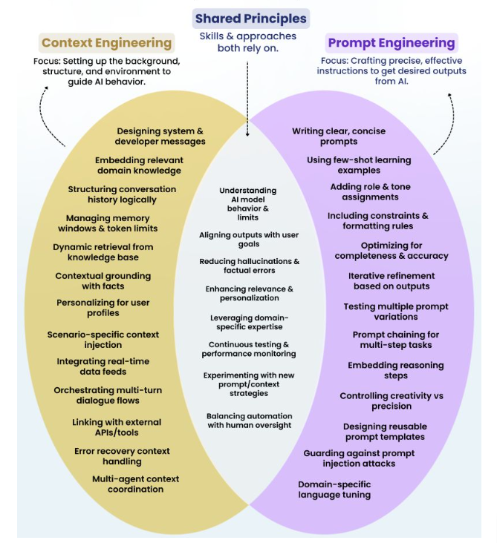
Context Based Prompt Engineering

Slide 61
Add-on Topics
Prompt libraries
Version-controlled prompts
Context templates
Customer vs Manager
Beginner vs Expert
Student vs Professional

Slide 62
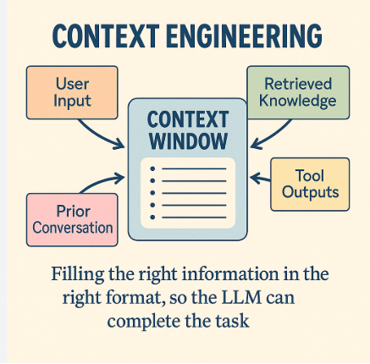
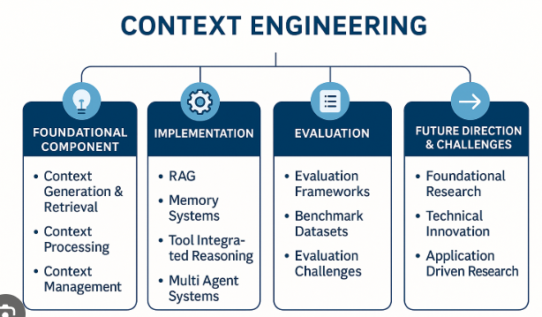
Context Engineering

